Slide 1
Algorithms and Data Structures for Logic Synthesis and Verification using Boolean Satisfiability
John Backes (back0145@umn.edu)
Advisor: Marc Riedel (mriedel@umn.edu)

Slide 2
Work Since Prelim
Regression Verification Using Impact Summaries – Sub. to CAV 2013
J. Backes, S. Person, N. Rungta, O. Tkachuk
Proteus: A Change Impact Analysis Framework
J. Backes, S. Person, N. Rungta, O. Tkachuk
Ghost Talk: Mitigating EMI Signal Injection Attacks against Analog Sensors – Oakland 2013
D. Kune, J. Backes, S. Clark, W. Xu, M. Reynolds, K. Fu, Y. Kim
Using Cubes of Non-state Variables With Property Directed Reachability – DATE 2013
J. Backes, M. Riedel

Slide 3
Overview of Topics

Slide 4
Overview of Topics

Slide 5
Overview of Topics

Slide 6
Overview of Topics

Slide 7
Overview of Topics

Slide 8
Overview of Topics
2
3
1

Slide 9
Theme: Synthesis + Verification

Slide 10
Contributions
Cyclic Circuits
SAT-Based Synthesis of Functions
SAT-Based Analysis and Mapping
Resolution Proofs
Reduction of Craig Interpolants
Use as Synthesis Data Structure
Property Directed Reachability
Extension to Non-state Variables

Slide 11
Background

Slide 12
Boolean Satisfiability
Is there some assignment of a, b, c, and d that satisfies this (CNF) formula?
(
a
+
¬
c
+
d
)(
¬
a
+
¬
c
+
d
)(
a
+
c
)(
¬
a
+
c
)(
¬
d
)
(
d
+
¬c
)(
a
+
b
)
“¬” or “x” is negation
“+” or “˅” is OR
“∙” or “˄” is AND
An appearance of a variable is a literal.
An OR of literals is a clause.

Slide 13
Boolean Satisfiability
Is there some assignment of a, b, c, and d that satisfies this (CNF) formula?
(
a
+
¬
c
+
d
)(
¬
a
+
¬
c
+
d
)(
a
+
c
)(
¬
a
+
c
)(
¬
d
)
(
d
+
¬c
)(
a
+
b
)
“¬” or “x” is negation
“+” or “˅” is OR
“∙” or “˄” is AND
An appearance of a variable is a literal.
An OR of literals is a clause.
(
c
) (
¬
c
)

Slide 14
Boolean Satisfiability
Is there some assignment of a, b, c, and d that satisfies this (CNF) formula?
(
a
+
¬
c
+
d
)(
¬
a
+
¬
c
+
d
)(
a
+
c
)(
¬
a
+
c
)(
¬
d
)
(
d
+
¬c
)(
a
+
b
)
“¬” or “x” is negation
“+” or “˅” is OR
“∙” or “˄” is AND
An appearance of a variable is a literal.
An OR of literals is a clause.
(
c
) (
¬
c
)
( )
UNSAT!

Slide 15
Boolean Satisfiability
The Original NP-Complete Problem (Cook–Levin theorem)
But can be very fast in practice
Used in Many Domains
Artificial Intelligence
Formal Verification
Logic Synthesis

Slide 16
Tseitin Transformation
Circuit can be converted into CNF formula in linear time (adding extra variables)
$$(x+z)(y+z)(¬x+¬y+¬z)$$

Slide 17
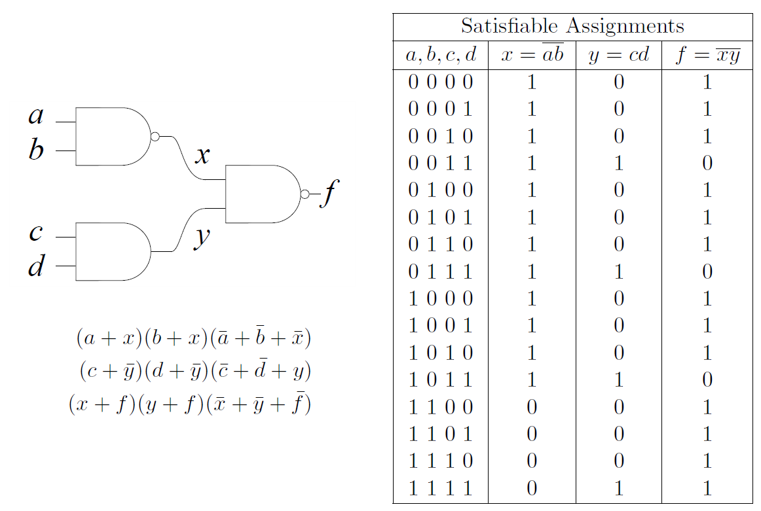
Tseitin Transformation

Slide 18
Tseitin Transformation
$$(a+x)(b+x)(¬a+¬b+¬x)$$

Slide 19
Tseitin Transformation
$$(a+x)(b+x)(¬a+¬b+¬x)$$
$$(c+¬y)(d+¬y)(¬c+¬d+y)$$

Slide 20
Tseitin Transformation
$$(a+x)(b+x)(¬a+¬b+¬x)$$
$$(c+¬y)(d+¬y)(¬c+¬d+y)$$
$$(x+f)(y+f)(¬x+¬y+¬f)$$

Slide 21
Use Cubes of Non-state Variables with PDR

Slide 22
Model Checking
What is model checking?
Given a mathematical model of some real-world system, does the model exhibit a property?
Models are transition systems (Finite state machines (FSMs))

Slide 23
Example: Wallace Algorithm

Slide 24
Example: Wallace Algorithm

Slide 25
Example: Wallace Algorithm

Slide 26
Example: Wallace Algorithm

Slide 27
Example: Wallace Algorithm

Slide 28
Example: Wallace Algorithm

Slide 29
Example: Wallace Algorithm

Slide 30
Example: Wallace Algorithm

Slide 31
Wallace Properties
“Wallace never returns to his bed after leaving”
“Wallace will always eventually eat”
“Wallace never immediately eats after drinking”

Slide 32
Symbolic Model Checking
Model checking suffers the “state-space explosion problem”
Algorithms use symbolic representation for sets of states
Original symbolic algorithms used BDDs more recent algorithms use SAT

Slide 33
Model Checking Example
State graph is described by transition relation

Slide 34
Model Checking Example
State graph is described by transition relation
Primary Inputs
State Inputs
State Outputs
Property Output

Slide 35
Model Checking Example
Property holds for n transitions if ¬P is UNSAT in unrolled transition relation

Slide 36
Model Checking Example
Property holds for n transitions if ¬P is UNSAT in unrolled transition relation

Slide 37
Model Checking Example
Property holds for n transitions if ¬P is UNSAT in unrolled transition relation

Slide 38
Model Checking Example
Property holds for n transitions if ¬P is UNSAT in unrolled transition relation

Slide 39
Model Checking Example
Property holds for n transitions if ¬P is UNSAT in unrolled transition relation

Slide 40
What is PDR?
Property Directed Reachability (PDR)
New symbolic model checking algorithm
Solves individual frames in isolation
Advantages over other algorithms
SAT-Based not BDD-Based
No need for long unrollings
No spurious counter examples

Slide 41
How does PDR work?
The trace contains sets of clauses F_{i} called frames.
Frame F_{i} symbolically represents over approximation of states reachable in i transitions.

Slide 42
How Does PDR Work?
CNF formula: T ⁰
CNF formula: T ¹
CNF formula: T ²

Slide 43
How Does PDR Work?
SAT?: I ˄ T ⁰ ˄ x’₁x’₂x’₃x’₄
SAT?: T ¹ ˄ x’₁x’₂x’₃x’₄
SAT?: T ² ˄ ¬P’
Result: UNSAT!
Result: x₁x₂x₃x₄
Result: x₁x₂x₃x₄

Slide 44
How Does PDR Work?
x₁x₂x₃x₄
x₁x₂x₃x₄
F₀
I
¬P
x₁x₂x₃x₄
CNF formula: T
x₁x₂x₃x₄
F_{i}
x₁x₂x₃
Cube Reduction!
x₁x₂x₄
SAT?: F_{i} ˄ T ˄ ¬P’
Prev State
Next State
SAT?: F_{i-1} ˄ T ˄ x’₁x’₂x’₃x’₄

Slide 45
How to improve PDR
PDR requires small cubes to be effective
Reductions via Ternary Valued Simulation
Reductions via MUC inspection
Idea: The use of non-state variables may yield smaller cubes

Slide 46
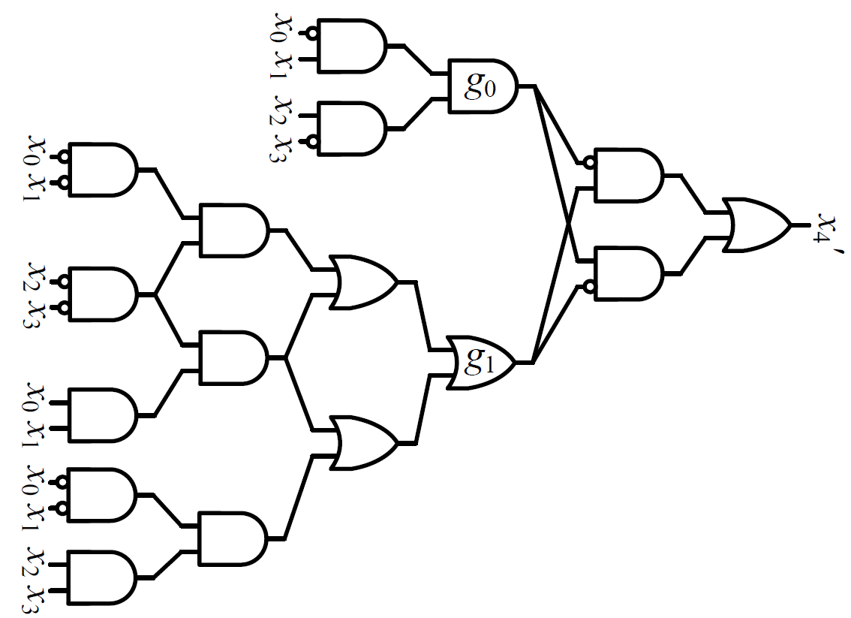
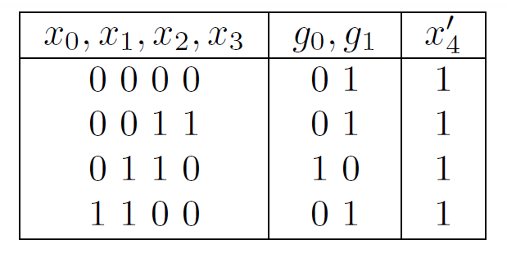
Intuition for Non-State Variables
F_{i-1}
Three cubes in terms of x₀x₁x₂x₃ blocked by one cube in terms of g₀g₁!
F_{i}

Slide 47
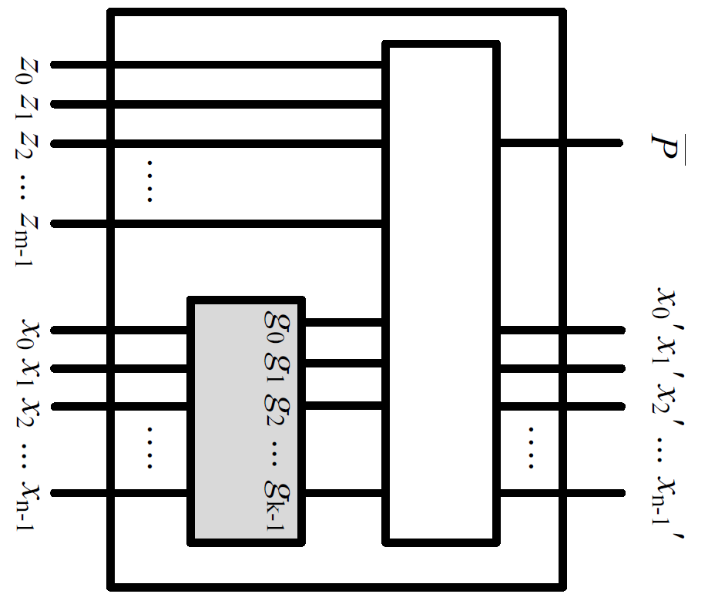
Shifting the Transition Relation
F_{i-1}
F_{i}

Slide 48
Shifting the Transition Relation
F_{i-1}
F_{i}

Slide 49
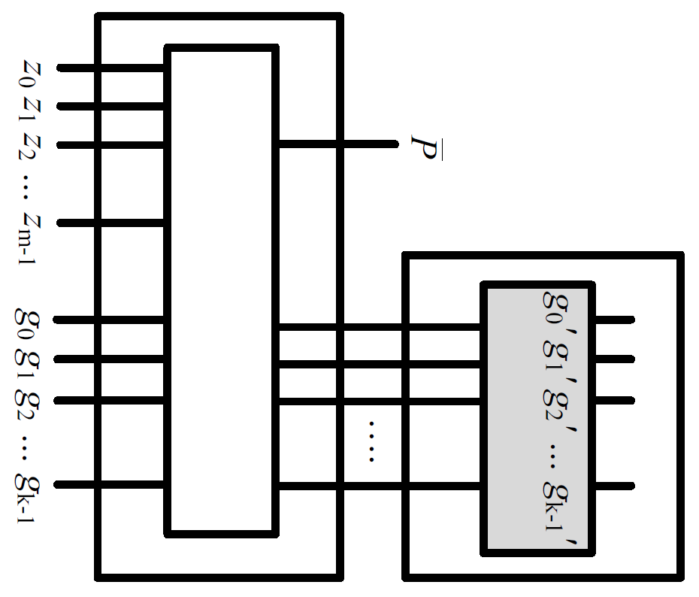
Shifting the Transition Relation
F_{i-1}
F_{i}

Slide 50
Ternary Valued Simulation
After solving Query: F_{i} ˄ T ˄ x’₆x’₇
Satisfying assignment: x₁x₂x₃x₄
“ ” is an
unknown value
┴

Slide 51
Ternary Valued Simulation
After solving Query: F_{i} ˄ T ˄ x’₆x’₇
Satisfying assignment: x₁x₂x₃x₄
“ ” is an
unknown value
┴

Slide 52
Ternary Valued Simulation
After solving Query: F_{i} ˄ T ˄ x’₆x’₇
Satisfying assignment: x₁x₂x₃x₄
“ ” is an
unknown value
┴

Slide 53
Ternary Valued Simulation
After solving Query: F_{i} ˄ T ˄ x’₆x’₇
Satisfying assignment: x₁x₂x₃x₄
“ ” is an
unknown value
┴

Slide 54
Ternary Valued Simulation
After solving Query: F_{i} ˄ T ˄ x’₆x’₇
Satisfying assignment: x₁x₂x₃x₄
“ ” is an
unknown value
┴

Slide 55
Ternary Valued Simulation
After solving Query: F_{i} ˄ T ˄ x’₆x’₇
Satisfying assignment: x₁x₂x₃x₄
“ ” is an
unknown value
┴

Slide 56
Ternary Valued Simulation
After solving Query: F_{i} ˄ T ˄ x’₆x’₇
Satisfying assignment: x₁x₂x₃x₄
“ ” is an
unknown value
┴

Slide 57
Ternary Valued Simulation
After solving Query: F_{i} ˄ T ˄ x’₆x’₇
Satisfying assignment: x₁x₂x₃x₄
Cube reduced: x₁x₃x₄
“ ” is an
unknown value
┴

Slide 58
Ternary Sim with Gate Vars
Slightly more complex because of variable dependence
Algorithm:
Order variables ascending by logic level
If the variables value is determined by fanins: remove it
Otherwise try setting to:
┴

Slide 59
Ternary Gate Vars Example
After solving Query: F_{i} ˄ T ˄ m’₀m’₁m’₂
Satisfying assignment: g₀g₁g₂

Slide 60
Ternary Gate Vars Example
After solving Query: F_{i} ˄ T ˄ m’₀m’₁m’₂
Satisfying assignment: g₀g₁g₂

Slide 61
Ternary Gate Vars Example
After solving Query: F_{i} ˄ T ˄ m’₀m’₁m’₂
Satisfying assignment: g₀g₁g₂

Slide 62
Ternary Gate Vars Example
After solving Query: F_{i} ˄ T ˄ m’₀m’₁m’₂
Satisfying assignment: g₀g₁g₂

Slide 63
Ternary Gate Vars Example
After solving Query: F_{i} ˄ T ˄ m’₀m’₁m’₂
Satisfying assignment: g₀g₁g₂
Reduced Cube: g₀g₁
Value Determined
by inputs!

Slide 64
Experimental Setup
Ternary sim run twice: only gate vars and only state vars
Vars are removed from cube by logic level and by priority
After both passes the smaller cube is chosen

Slide 65
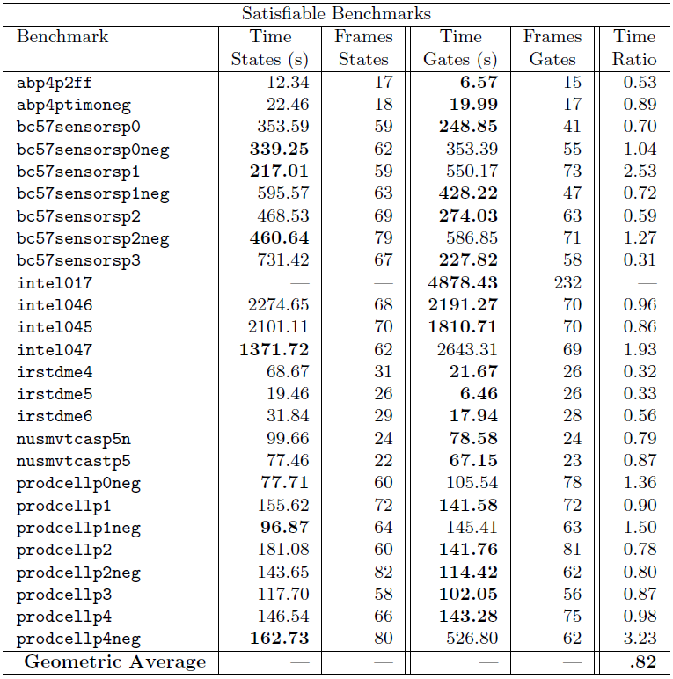
SAT Results

Slide 66
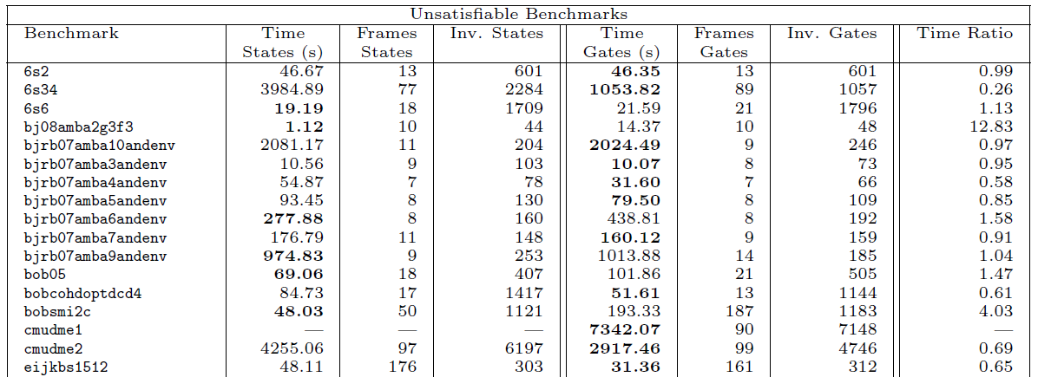
UNSAT Results
…
…
…
…
…
…
…
…

Slide 67
Discussion
Extension seems to work well for satisfiable benchmarks
Does not seem to work as well for unsatisfiable benchmarks
Randomness also affects the results.

Slide 68
Other Things We Tried
Probabilistically chose gate variables
Used simulated annealing type approach that gradually changed from gate cubes to state cubes
Placed limits on max height of logic level used

Slide 69
Synthesizing Cyclic Dependencies with Craig Interpolation

Slide 70
Craig Interpolation
Given formulas A and B such that A → ¬B, there exists I such that A → I → ¬B
I only contains variables that are present in both A and B.
I
B
A

Slide 71
Craig Interpolation Cont.
For an instance of unsatisfiablity, if the clauses are divided into sets A and B then A → ¬B.
An interpolant I can be generated from a proof of unsatisfiability of A and B.
The structure of this proof influences the structure of I

Slide 72
Generating I Example
(
a
+
¬
c
+
d
)(
¬
a
+
¬
c
+
d
)(
a
+
c
)(
¬
a
+
c
)(
¬
d
)
(
d
+
¬c
)(
a
+
b
)
(
c
) (
¬
c
)
( )

Slide 73
Generating I Example
(
a
+
¬
c
+
d
)(
¬
a
+
¬
c
+
d
)(
a
+
c
)(
¬
a
+
c
)(
¬
d
)
(
d
+
¬c
)(
a
+
b
)
(
c
) (
¬
c
)
( )

Slide 74
Generating I Example
(
a
+
c
)(
¬
a
+
c
)(
¬
d
)
(
d
+
¬c
)
(
c
) (
¬
c
)
( )

Slide 75
Generating I Example
a c ¬a c
(
a
+
c
)(
¬
a
+
c
)(
¬
d
)
(
d
+
¬c
)
(
c
) (
¬
c
)
( )

Slide 76
Generating I Example
a c ¬a c
)(
¬
d
)
(
d
+
¬c
)
(
c
) (
¬
c
)
( )

Slide 77
Generating I Example
a c ¬a c
(
¬
d
)
(
c
) (
¬
c
)
( )

Slide 78
Generating I Example
a c ¬a c
(
¬
d
)
¬d
( )

Slide 79
Generating I Example
a c ¬a c
I
B
¬d
A
I(a,c)

Slide 80
Applications
Model Checking¹
Interpolants are used to over approximate the set of reachable states in a transition relation.
Functional Dependencies²
Interpolants are used to generate a dependency function in terms of a specified support set.
The size of the interpolant directly correlates to the size of the circuit implementation.
¹(K. L. McMillan. Interpolation and SAT-based model checking. ICCAV, 2003.)
²C.-C. Lee, J.-H. R. Jiang, C.-Y. Huang, and A. Mishchenko. Scalable exploration of functional dependency by interpolation and incremental SAT solving. ICCAD, 2007.

Slide 81
Cyclic Combinational Circuits
Cyclic Circuit: 2 functions, 5 variables, 2 fan-in 4 gates.
a
c
b
d
c
e
Acyclic Circuit: at least 3 fan-in 4 gates.

Slide 82
How can one make a cyclic circuit?
Consider some acyclic circuit
Pick support variables
Pick target support sets in a cyclic fashion

Slide 83
What is wrong with the old approach?
Old method uses BDDs.
These do not scale well with circuit size.
Old method for functional dependencies relies on algebraic manipulation.
Also does not scale well with circuit size.

Slide 84
What is better with the new approach
Uses SAT-based method for functional dependency.
SAT-based cyclic analysis during synthesis.
This scales better for larger circuits.

Slide 85
Functional Dependency
a | b | c | f₀ | f₁
0 | 0 | 0 | 1 | 1
0 | 0 | 1 | 0 | 1
0 | 1 | 0 | 0 | 0
0 | 1 | 1 | 1 | 0
1 | 0 | 0 | 0 | 0
1 | 0 | 1 | 0 | 1
1 | 1 | 0 | 0 | 0
1 | 1 | 1 | 1 | 0
Two functions of three variables.
For every assignment of f₀ and c, there is a unique value for f₁.
This is necessary and sufficient to express f₁ in terms of f₀ and c.

Slide 86
Functional Dependency
a | b | c | f₀ | f₁
0 | 0 | 0 | 1 | 1
0 | 0 | 1 | 0 | 1
0 | 1 | 0 | 0 | 0
0 | 1 | 1 | 1 | 0
1 | 0 | 0 | 0 | 0
1 | 0 | 1 | 0 | 1
1 | 1 | 0 | 0 | 0
1 | 1 | 1 | 1 | 0
Two functions of three variables.
For every assignment of f₀ and c, there is a unique value for f₁.
This is necessary and sufficient to express f₁ in terms of f₀ and c.

Slide 87
Functional Dependency
a | b | c | f₀ | f₁
0 | 0 | 0 | 1 | 1
0 | 0 | 1 | 0 | 1
0 | 1 | 0 | 0 | 0
0 | 1 | 1 | 1 | 0
1 | 0 | 0 | 0 | 0
1 | 0 | 1 | 0 | 1
1 | 1 | 0 | 0 | 0
1 | 1 | 1 | 1 | 0
Two functions of three variables.
For every assignment of f₀ and c, there is a unique value for f₁.
This is necessary and sufficient to express f₁ in terms of f₀ and c.

Slide 88
Functional Dependency
a | b | c | f₀ | f₁
0 | 0 | 0 | 1 | 1
0 | 0 | 1 | 0 | 1
0 | 1 | 0 | 0 | 0
0 | 1 | 1 | 1 | 0
1 | 0 | 0 | 0 | 0
1 | 0 | 1 | 0 | 1
1 | 1 | 0 | 0 | 0
1 | 1 | 1 | 1 | 0
Two functions of three variables.
For every assignment of f₀ and c, there is a unique value for f₁.
This is necessary and sufficient to express f₁ in terms of f₀ and c.

Slide 89
Functional Dependency
a | b | c | f₀ | f₁
0 | 0 | 0 | 1 | 1
0 | 0 | 1 | 0 | 1
0 | 1 | 0 | 0 | 0
0 | 1 | 1 | 1 | 0
1 | 0 | 0 | 0 | 0
1 | 0 | 1 | 0 | 1
1 | 1 | 0 | 0 | 0
1 | 1 | 1 | 1 | 0
Two functions of three variables.
For every assignment of f₀ and c, there is a unique value for f₁.
This is necessary and sufficient to express f₁ in terms of f₀ and c.

Slide 90
Functional Dependency
a | b | c | f₀ | f₁
0 | 0 | 0 | 1 | 1
0 | 0 | 1 | 0 | 1
0 | 1 | 0 | 0 | 0
0 | 1 | 1 | 1 | 0
1 | 0 | 0 | 0 | 0
1 | 0 | 1 | 0 | 1
1 | 1 | 0 | 0 | 0
1 | 1 | 1 | 1 | 0
Two functions of three variables.
For every assignment of f₀ and c, there is a unique value for f₁.
This is necessary and sufficient to express f₁ in terms of f₀ and c.
c | f₀ | f₁
0 | 0 | 0
0 | 1 | 1
1 | 0 | 1
1 | 1 | 0

Slide 91
Functional Dependency
C.-C. Lee, J.-H. R. Jiang, C.-Y. Huang, and A. Mishchenko, “Scalable exploration of functional dependency by interpolation and incremental SAT solving”, ICCAD ‘07
Tells us if f₀ (x₀, x₁, … , x_{n}) can be expressed in terms of some function h (f₀, f₁, f₂, f₃)
If SAT, the dependency function h does not exist.
If UNSAT, Craig Interpolation can be used to derive an expression for h.

Slide 92
Cyclic Dependency
a | b | f₁ | f₀
0 | 0 | 0 | 1
0 | 0 | 1 | 1
0 | 1 | 0 | 0
0 | 1 | 1 | 1
1 | 0 | 0 | 0
1 | 0 | 1 | 0
1 | 1 | 0 | 1
1 | 1 | 1 | 1
a | c | f₀ | f₁
0 | 0 | 0 | 1
0 | 0 | 1 | 0
0 | 1 | 0 | 1
0 | 1 | 1 | 1
1 | 0 | 0 | 0
1 | 0 | 1 | 0
1 | 1 | 0 | 0
1 | 1 | 1 | 0
A cyclic dependency is combinational if for every assignment of primary input variables, every function has a definite value.

Slide 93
Cyclic Dependency
a=b=0 controls f₀
a | b | f₁ | f₀
0 | 0 | 0 | 1
0 | 0 | 1 | 1
0 | 1 | 0 | 0
0 | 1 | 1 | 1
1 | 0 | 0 | 0
1 | 0 | 1 | 0
1 | 1 | 0 | 1
1 | 1 | 1 | 1
a | c | f₀ | f₁
0 | 0 | 0 | 1
0 | 0 | 1 | 0
0 | 1 | 0 | 1
0 | 1 | 1 | 1
1 | 0 | 0 | 0
1 | 0 | 1 | 0
1 | 1 | 0 | 0
1 | 1 | 1 | 0
A cyclic dependency is combinational if for every assignment of primary input variables, every function has a definite value.
a=c=1 controls f₁

Slide 94
Cyclic Dependency
a=c=0, b=1 controls neither!
a | b | f₁ | f₀
0 | 0 | 0 | 1
0 | 0 | 1 | 1
0 | 1 | 0 | 0
0 | 1 | 1 | 1
1 | 0 | 0 | 0
1 | 0 | 1 | 0
1 | 1 | 0 | 1
1 | 1 | 1 | 1
a | c | f₀ | f₁
0 | 0 | 0 | 1
0 | 0 | 1 | 0
0 | 1 | 0 | 1
0 | 1 | 1 | 1
1 | 0 | 0 | 0
1 | 0 | 1 | 0
1 | 1 | 0 | 0
1 | 1 | 1 | 0
A cyclic dependency is combinational if for every assignment of primary input variables, every function has a definite value.

Slide 95
Cyclic Dependency
a=c=0, b=1 controls neither!
a | b | f₁ | f₀
0 | 0 | 0 | 1
0 | 0 | 1 | 1
0 | 1 | 0 | 0
0 | 1 | 1 | 1
1 | 0 | 0 | 0
1 | 0 | 1 | 0
1 | 1 | 0 | 1
1 | 1 | 1 | 1
a | c | f₀ | f₁
0 | 0 | 0 | 1
0 | 0 | 1 | 0
0 | 1 | 0 | 1
0 | 1 | 1 | 1
1 | 0 | 0 | 0
1 | 0 | 1 | 0
1 | 1 | 0 | 0
1 | 1 | 1 | 0
The circuit is not combinational if three conditions are satisfied
All primary input variables the same in each row.
Controlling values are propagated.
Some function is toggling.

Slide 96
Cyclic Dependency
Create a SAT instance that satisfies three conditions.
A Left and a Right copy of each dependency function.
Each copy considers one row of the truth table.

Slide 97
Synthesizing Cyclic Dependencies
Select a candidate set of target functions and support sets.
Generate their implementations via Craig Interpolation.
Use branch and bound search to pick solution.
Use SAT to verify if solution is combinational.

Slide 112
What are the problems with the new approach?
The structure of the interpolants is relatively poor.
Because of this, we use support set size as our cost function.
This can be a valid metric for FPGAs.

Slide 113
Reduction of Interpolants For Logic Synthesis

Slide 114
Generating I Example
a c ¬a c
(
a
+
¬
c
+
d
)(
¬
a
+
¬
c
+
d
)(
a
+
c
)(
¬
a
+
c
)(
¬
d
)
(
d
+
¬c
)(
a
+
b
)
(
c
) (
¬
c
)
¬d
( )

Slide 115
Generating I Example
(
a
+
¬
c
+
d
)(
¬
a
+
¬
c
+
d
)(
a
+
c
)(
¬
a
+
c
)(
¬
d
)
(
d
+
¬c
)(
a
+
b
)
(
d
+
¬c
)
(
¬
c
)
(
c
)
( )

Slide 116
Generating I Example
>

Slide 117
Draw Backs
Model Checking
Interpolants that are large over approximations can trigger false state reachability.
Functional Dependencies
In many cases the structure of the interpolant may be very redundant and large.

Slide 118
Proposed Solution
Goal: reduce size of an interpolant generated from a resolution proof.
Change the structure of a proof with the aim of reducing interpolant size.
In general, the fewer intermediate nodes in the proof, the smaller then interpolant.

Slide 119
Resolution Proofs
A proof of unsatisfiability for an in instance of SAT forms a graph structure.
The original clauses are called the roots and the empty clause is the only leaf.
Every node in the graph (besides the roots) is formed via Boolean resolution.
I.e.: (c + d)(¬c + e) → (d + e)
Here “c” is referred to as the pivot variable.

Slide 120
Generating Interpolants
Interpolants are generated by calling a recursive function on the empty clause.
Logic gates are created on the intermediate nodes.
The function of the gate depends on which set of root nodes the pivot variable is present in.
The procedure terminates on root nodes.

Slide 121
Proposition 1
Nodes resolved only from A (or B) can be considered as roots of A (or B).
Proof: Given clauses C, D, and E such that (C)(D) → (E), (C)(D) ≡ (C)(D)(E).
I
B
A

Slide 122
Example
(
a
+
¬
c
+
d
)(
¬
a
+
¬
c
+
d
)(
a
+
c
)(
¬
a
+
c
)(
¬
d
)
(
d
+
¬c
)(
a
+
b
)
(
c
) (
¬
c
)
( )

Slide 123
Example
(
a
+
¬
c
+
d
)(
¬
a
+
¬
c
+
d
)(
a
+
c
)(
¬
a
+
c
)(
¬
d
)
(
d
+
¬c
)(
a
+
b
)
(
c
) (
¬
c
)
( )

Slide 124
Example
(
a
+
¬
c
+
d
)(
¬
a
+
¬
c
+
d
)(
a
+
c
)(
¬
a
+
c
)(
¬
d
)
(
d
+
¬c
)(
a
+
b
)
(
d
+
¬c
)
(
¬
c
)
(
c
)
( )

Slide 125
Example
(
a
+
¬
c
+
d
)(
¬
a
+
¬
c
+
d
)(
a
+
c
)(
¬
a
+
c
)(
¬
d
)
(
d
+
¬c
)(
a
+
b
)
(
d
+
¬c
)
0
(
¬
c
)
(
c
)
( )

Slide 126
Observation
Proofs with few resolutions between clauses of A and B will tend to have smaller interpolants.
We refer to nodes that have ancestors for A and B as mixed nodes.
We refer to proofs with few mixed nodes as being more disjoint.
Our goal: find a more disjoint proof before generating the interpolant.

Slide 127
Proposition 2
If node c in a proof is implied by root nodes R, then all assignments that satisfy the clauses of R also satisfy c
Proof: since R → c, whenever R = 1, c = 1

Slide 128
SAT Based Methods
Since R → c the SAT instance (R)(¬c) will be unsatisfiable.
R. Gershman used this observation to find Minimum Unsatisfiable Cores (MUCs) for resolution proofs¹.
¹R. Gershman, M. Koifman, and O. Strichman. An approach for extracting a small unsatisfiable core. Formal Methods in System Design, 2008.

Slide 129
Example
(
a
+
¬
c
+
d
)(
¬
a
+
¬
c
+
d
)(
a
+
c
)(
¬
a
+
c
)(
¬
d
)
(
d
+
¬c
)(
a
+
b
)
What if we want to know if (¬c) can be implied by A?
Check the satisfiability of:
(
c
) (
¬
c
)
Root of A?
( )
(a + ¬c + d)(¬a + ¬c + d)(a+ c)(¬a + c)(¬d)(c)
=
UNSAT!

Slide 130
Example
(
a
+
¬
c
+
d
)(
¬
a
+
¬
c
+
d
)(
a
+
c
)(
¬
a
+
c
)(
¬
d
)
(
d
+
¬c
)(
a
+
b
)
What if we want to know if ( ) can be implied by A?
Check the satisfiability of:
(
c
) (
¬
c
)
( )
Root of A?
(a + ¬c + d)(¬a + ¬c + d)(a+ c)(¬a + c)(¬d)
=
UNSAT!

Slide 131
Example
(
a
+
¬
c
+
d
)(
¬
a
+
¬
c
+
d
)(
a
+
c
)(
¬
a
+
c
)(
¬
d
)
(
d
+
¬c
)(
a
+
b
)
What if we want to know if ( ) can be implied by A?
Check the satisfiability of:
(
c
) (
¬
c
)
( )
Root of A?
(a + ¬c + d)(¬a + ¬c + d)(a+ c)(¬a + c)(¬d)
=
UNSAT!

Slide 132
Proposed Method

Slide 133
Optimizations
The complexity of this approach is dominated by solving different SAT instances.
We can reduce the number of calls to the SAT solver by checking mixed nodes in specific orders.

Slide 134
Optimization 1
...( )( )( )( )
( )( )( )...
……
..
If node 1 is a root of A (B) then we don’t need to check node 3.
(
3
) (
4
) (
5
)
(
1
) (
2
)
( )

Slide 135
Optimization 1
...( )( )( )( )
( )( )( )...
……
..
If node 1 is a root of A (B) then we don’t need to check node 3.
(
3
) (
4
) (
5
)
(
1
) (
2
)
( )

Slide 136
Optimization 1
...( )( )( )( )
( )( )( )...
……
..
If nodes 1 and 2 are roots of A (B) then we don’t need to check nodes 3 4 or 5.
(
3
) (
4
) (
5
)
(
1
) (
2
)
( )

Slide 137
Optimization 1
...( )( )( )( )
( )( )( )...
……
..
If nodes 1 and 2 are roots of A (B) then we don’t need to check nodes 3 4 or 5.
(
3
) (
4
) (
5
)
(
1
) (
2
)
Checking nodes near the leaf first is a backward search
( )

Slide 138
Optimization 2
...( )( )( )( )
( )( )( )...
……
..
If nodes and 3 and 4 are roots of A (B) then node 1 can be considered a root of A (B)
(
3
) (
4
) (
5
)
(
1
) (
2
)
( )

Slide 139
Optimization 2
...( )( )( )( )
( )( )( )...
……
..
If nodes and 3 and 4 are roots of A (B) then node 1 can be considered a root of A (B)
(
3
) (
4
) (
5
)
(
1
) (
2
)
( )

Slide 140
Optimization 2
...( )( )( )( )
( )( )( )...
……
..
If nodes and 3 and 4 are roots of A (B) then node 1 can be considered a root of A (B)
(
3
) (
4
) (
5
)
(
1
) (
2
)
Checking nodes near the roots first is a forward search
( )

Slide 141
Forward vs. Backward Search
Backward Search
Eliminates many mixed nodes at once
May take many SAT checks before we prove a node to be a root.
Forward Search
Nodes toward the beginning are more likely to be roots
May require more checks then backward search.

Slide 142
Incremental Techniques
Each call to the SAT solver is very similar.
Each instance is in the form (A)(¬c) or (B)(¬c).
The negated literals of clause c can be set as unit assumptions to the SAT Solver.
We then just solve the same instance repeatedly with different assumptions.
Variables a_{off} and b_{off} can be added to the clauses of A and B respectively.

Slide 143
Example
(
a
+
¬
c
+
d
)(
¬
a
+
¬
c
+
d
)(
a
+
c
)(
¬
a
+
c
)(
¬
d
)
(
d
+
¬c
)(
a
+
b
)
What if we want to know if (d + ¬c) can be implied by A?
Assume a_{off} = 0, b_{off} = 1, d = 0, and c = 1. Then check the satisfiability of:
Root of A?
(
c
) (
¬
c
)
( )
(a + ¬c + d + a_{off})(¬a + ¬c + d + a_{off})(a+ c + a_{off})(¬a + c + a_{off}) (¬d + a_{off})(d + ¬c + b_{off})(a + b + b_{off})
= UNSAT!

Slide 144
Experiment
Searched for different functional dependencies in benchmark circuits.
Found small support sets for POs expressed in terms of other POs and PIs.
Performed forward and backward search on the resolution proofs.
The number of SAT checks was limited to 2500.
This limit was reached for the larger proofs.

Slide 145
Experiment Cont.
After the new interpolants from the modified resolution proofs are. generated, the size is compared to the un modified proofs.
The size after running logic minimization on the modified and non modified interpolants is also compared.

Slide 146
Results (table3 benchmark)
table3 Benchmark: Forward Search
Function | # Nodes | Orig Size | New Size | Checked | Found | Time (s) | Orig Reduced | New Reduced | Ratio
0 | 32262 | 277 | 267 | 2500 | 61 | 80.85 | 105 | 93 | 0.89
1 | 128654 | 1254 | 1254 | 2500 | 0 | 281.31 | 328 | 329 | 1.00
2 | 95042 | 638 | 630 | 2500 | 283 | 218.25 | 248 | 226 | 0.91
3 | 71647 | 682 | 648 | 2500 | 423 | 157.66 | 273 | 215 | 0.79
4 | 57015 | 776 | 743 | 2500 | 432 | 126.26 | 380 | 364 | 0.96
5 | 47285 | 657 | 657 | 2500 | 0 | 106.23 | 251 | 233 | 0.93
6 | 43884 | 268 | 245 | 2500 | 578 | 94.67 | 91 | 104 | 1.14
7 | 26714 | 287 | 271 | 2500 | 335 | 64.37 | 144 | 126 | 0.88
8 | 31715 | 116 | 90 | 2500 | 48 | 79.4 | 55 | 34 | 0.62
9 | 13182 | 43 | 36 | 1090 | 65 | 17.25 | 22 | 18 | 0.82
10 | 70964 | 867 | 850 | 2500 | 576 | 146.85 | 413 | 397 | 0.96
11 | 31772 | 253 | 229 | 2500 | 67 | 80.12 | 86 | 107 | 1.24
12 | 45784 | 376 | 360 | 2500 | 404 | 98.61 | 172 | 184 | 1.07
13 | 29078 | 408 | 373 | 2500 | 757 | 64.73 | 130 | 55 | 0.42

Slide 147
Results (table3 benchmark)
table3 Benchmark: Backward Search
Function | Nodes | Orig Size | New Size | Checked | Found | Time (s) | Orig Reduced | New Reduced | Ratio
0 | 32262 | 277 | 129 | 2500 | 20 | 85.88 | 105 | 58 | 0.55
1 | 128654 | 1254 | 1238 | 2500 | 5 | 287.62 | 328 | 346 | 1.05
2 | 95042 | 638 | 574 | 2500 | 8 | 225.37 | 248 | 217 | 0.88
3 | 71647 | 682 | 469 | 2500 | 45 | 179.96 | 273 | 177 | 0.65
4 | 57015 | 776 | 490 | 2500 | 26 | 144.83 | 380 | 193 | 0.51
5 | 47285 | 657 | 611 | 2500 | 8 | 114.33 | 251 | 242 | 0.96
6 | 43884 | 268 | 224 | 2500 | 8 | 107.96 | 91 | 106 | 1.16
7 | 26714 | 287 | 87 | 2500 | 27 | 76.61 | 144 | 51 | 0.35
8 | 31715 | 116 | 76 | 2500 | 15 | 85.23 | 55 | 34 | 0.62
9 | 13182 | 43 | 36 | 1017 | 3 | 16.55 | 22 | 18 | 0.82
10 | 70964 | 867 | 349 | 2500 | 41 | 179.22 | 413 | 192 | 0.46
11 | 31772 | 253 | 191 | 2500 | 8 | 82.38 | 86 | 50 | 0.58
12 | 45784 | 376 | 203 | 2500 | 34 | 120 | 172 | 117 | 0.68
13 | 29078 | 408 | 112 | 2500 | 32 | 84.29 | 130 | 37 | 0.28

Slide 148
Results (Summarized)
Forward Search
Benchmark | Nodes | Checked | Found | % Change | % Change Reduced | Time (s)
apex1 | 28279 | 2413 | 30 | -4.89% | -2.73% | 69.48
apex3 | 68585 | 1494 | 21 | -2.12% | -1.47% | 140.99
styr | 9373 | 2143 | 88 | -8.71% | -5.71% | 18.3
s1488 | 5748 | 824 | 29 | -9.24% | -8.41% | 7.62
s1494 | 10488 | 1266 | 21 | -6.69% | -4.43% | 15.51
s641 | 46416 | 1886 | 39 | -26.67% | -2.33% | 97.45
s713 | 42412 | 1910 | 89 | -36.00% | -3.70% | 89.16
table5 | 35373 | 2500 | 252 | -13.83% | -4.08% | 48.05
vda | 12951 | 2011 | 120 | -18.78% | -17.33% | 27.34
sbc | 13951 | 1094 | 8 | -1.46% | -1.08% | 19.09

Slide 149
Results (Summarized)
Backward Search
Benchmark | Nodes | Checked | Found | % Change | % Change Reduced | Time (s)
apex1 | 28279 | 2384 | 6 | -8.95% | -5.84% | 72.03
apex3 | 68585 | 1485 | 5 | -8.41% | -5.24% | 145.63
styr | 9373 | 2124 | 10 | -11.57% | -10.14% | 19.36
s1488 | 5748 | 797 | 5 | -9.92% | -9.59% | 7.98
s1494 | 10488 | 1241 | 7 | -6.93% | -5.19% | 15.83
s641 | 46416 | 1820 | 14 | -42.22% | -2.78% | 95.37
s713 | 42412 | 1724 | 17 | -43.90% | -6.20% | 82.86
table5 | 35373 | 2358 | 7 | -26.67% | -15.83% | 81.16
vda | 12951 | 1850 | 7 | -21.72% | -19.72% | 27.07
sbc | 13951 | 1087 | 1 | -1.46% | -0.92% | 19.09

Slide 150
Summary of Thesis

Slide 151
The Analysis of Cyclic Circuits with Boolean Satisfiability (ICCAD08)
SAT-based algorithm for analyzing cyclic circuits on the gate level.
Also work discussing mapping of cyclic circuits.

Slide 152
The Analysis of Cyclic Circuits with Boolean Satisfiability (ICCAD08)
1
1

Slide 153
The Analysis of Cyclic Circuits with Boolean Satisfiability (ICCAD08)

Slide 154
The Synthesis of Cyclic Dependencies with Craig Interpolation (IWLS09, TODAES12)
Used SAT for functional level analysis
Craig Interpolation to generate the dependencies
Branch and bound to find different solutions

Slide 155
The Synthesis of Cyclic Dependencies with Craig Interpolation (IWLS09, TODAES12)
Consider some acyclic circuit
Pick support variables
Pick target support sets in a cyclic fashion

Slide 156
Reduction of Interpolants For Logic Synthesis (ICCAD10)
Restructured resolution proofs to make smaller interpolants
Used incremental SAT techniques to increase performance

Slide 157
Reduction of Interpolants For Logic Synthesis (ICCAD10)
(
a
+
¬
c
+
d
)(
¬
a
+
¬
c
+
d
)(
a
+
c
)(
¬
a
+
c
)(
¬
d
)
(
d
+
¬c
)(
a
+
b
)
(
a
+
¬
c
+
d
)(
¬
a
+
¬
c
+
d
)(
a
+
c
)(
¬
a
+
c
)(
¬
d
)
(
d
+
¬c
)(
a
+
b
)
(
a
+
¬
c
+
d
)(
¬
a
+
¬
c
+
d
)(
a
+
c
)(
¬
a
+
c
)(
¬
d
)
(
d
+
¬c
)(
a
+
b
)
0
(
d
+
¬c
)
(
c
) (
¬
c
)
(
d
+
¬c
)
(
¬
c
)
(
c
)
( )
(
¬
c
)
(
c
)
( )
( )

Slide 158
Resolution Proofs as a Data Structure For Logic Synthesis (IWLS11)
Advocated using resolution proofs to perform large restructurings
Showed that many nodes can be shared among similar proofs

Slide 159
Resolution Proofs as a Data Structure For Logic Synthesis (IWLS11)
f_{j} (x₁,x₂,x₃,x₄,x₅,x₆)?
f_{k} (x₁,x₂,x₃,x₄,x₅,x₆)?

Slide 160
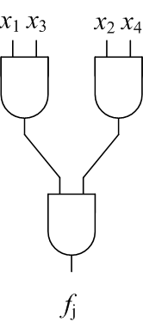
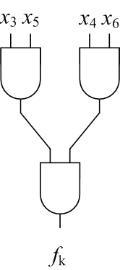
Resolution Proofs as a Data Structure For Logic Synthesis (IWLS11)
f_{j} (x₁,x₂,x₃,x₄,x₅,x₆)?
f_{k} (x₁,x₂,x₃,x₄,x₅,x₆)?

Slide 161
Resolution Proofs as a Data Structure For Logic Synthesis (IWLS11)
f_{j} (x₁,x₂,x₃,x₄,x₅,x₆)?
f_{k} (x₁,x₂,x₃,x₄,x₅,x₆)?

Slide 162
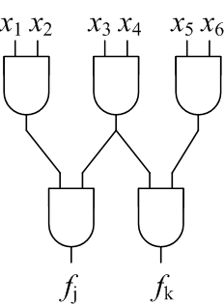
Resolution Proofs as a Data Structure For Logic Synthesis (IWLS11)
f_{j} (x₁,x₂,x₃,x₄,x₅,x₆)?
f_{k} (x₁,x₂,x₃,x₄,x₅,x₆)?

Slide 163
PDR and Gate Variables (DATE13)
Extended PDR algorithm to use cubes of non-state variables
Improved performance for satisfiable benchmarks

Slide 164
PDR and Gate Variables (DATE13)
F_{i-1}
F_{i}

Slide 165
PDR and Gate Variables (DATE13)
PI Vars
Next State Vars
Gate Vars
State Vars

Slide 166
PDR and Gate Variables (DATE13)
PI Vars
Next Gate Vars
Gate Vars

Slide 167
Future Directions

Slide 168
Cyclic Re-Writing
DAG-Aware AIG Re-Writing is powerful for acyclic circuits
Uses pre-computed functions
Computes feasible cuts of the circuit
Can re-writing be performed with cyclic circuits?

Slide 169
Cyclic Re-Writing Challenges
After each cut is replaced combinational analysis must be performed
We can use SAT-Based analysis!
Re-writing would require a database of good cyclic functions
Cyclic circuits implementing a single function?

Slide 170
Single Output Cyclic Circuits
Do there exists small cyclic circuits implementing a single function?

Slide 171
Single Output Cyclic Circuits
Do there exists small cyclic circuits implementing a single function?

Slide 172
Resolution Proofs and Interpolants
Techniques may be extended to improve abstractions (over-approximations)
Methods for generating good initial proofs (rather than quickly solving instances)

Slide 173
Property Directed Reachability
The algorithm is very young
New heuristics for cube minimization
Possible extensions to probabilistic model checking

Slide 174
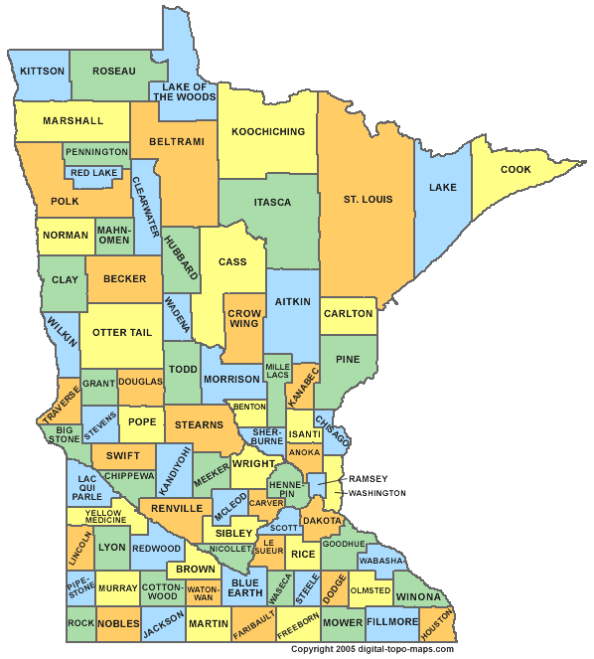
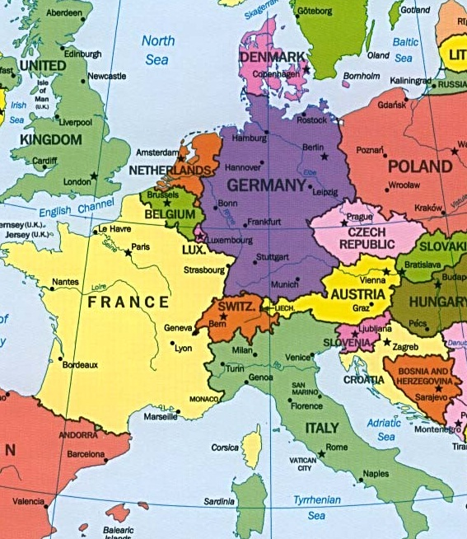
Future Plans

Slide 175
Resolution Proofs as a Universal Data Structure for Logic Synthesis

Slide 176
Data Structures
Sum of Products (SOPs)
Advantages: explicit, readily mapable.
Disadvantages: not scalable.
Binary Decision Diagrams (BDDs)
Advantages: canonical, easily manipulated.
Disadvantages: not readily mapable, not scalable.

Slide 177
Data Structures
And Inverter Graphs (AIGs)
Advantages:
Compact.
Easily convertible to CNFs.
Scalable, efficient.
Disadvantages:
Hard to perform large structural changes.

Slide 178
Resolution Proofs
Implicitly extracted from SAT solvers; converted to logic via Craig Interpolation.
Utilize as a data structure to perform logic manipulations.
Advantages:
Scalable, efficient.
Can effect large structural changes.

Slide 179
AIG Synthesis
Re-writing
Cuts are replaced by pre-computed optimal structures (Mishchenko ’06).
SAT Sweeping
Nodes of an AIG can be merged by proven equivalence (Zhu ‘06).
SAT-Based Resubstitution
Target nodes are recomputed from other nodes (Lee ‘07).

Slide 180
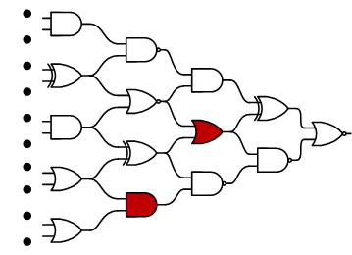
AIG Synthesis
SAT-Sweeping (merging equivalent nodes)

Slide 181
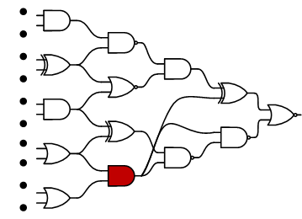
AIG Synthesis
SAT-Sweeping (merging equivalent nodes)

Slide 182
AIG Synthesis
AIG re-writing
Local manipulations performed on windows
Local minimums can be reached

Slide 183
AIG Synthesis
AIG re-writing
Local manipulations performed on windows
Local minimums can be reached

Slide 184
AIG Synthesis
AIG re-writing
Local manipulations performed on windows
Local minimums can be reached

Slide 185
Resubstitution a.k.a. Functional Dependencies
Given target:
f (z₁,z₂,…,z_{n}),
Given candidates: x₁(z₁,z₂,…,z_{n}), x₂(z₁,z₂,…,z_{n}), …, x_{m}(z₁,z₂,…,z_{n})
is it possible to implement f (x₁,x₂,…,x_{m})?

Slide 186
Aig Synthesis
Resubstitution
f (x₁,x₂)?

Slide 187
Aig Synthesis
Resubstitution
f (x₁,x₂)?
Large changes
This question is formulated as a SAT instance.
Craig Interpolation provides implementation.

Slide 188
Generating Multiple Dependencies
Often, goal is to synthesize dependencies for multiple functions with overlapping support sets.
In this case, multiple proofs are generated and then interpolated.

Slide 189
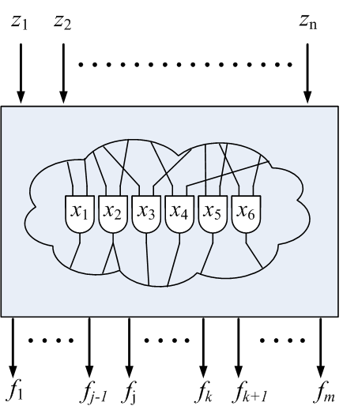
Example
Large portions of a network can be converted to a resolution proof.
f_{j} (x₁,x₂,x₃,x₄,x₅,x₆)?
f_{k} (x₁,x₂,x₃,x₄,x₅,x₆)?

Slide 190
Example
f_{j} (x₁,x₂,x₃,x₄,x₅,x₆)?
f_{k} (x₁,x₂,x₃,x₄,x₅,x₆)?

Slide 191
Example
f_{j} (x₁,x₂,x₃,x₄,x₅,x₆)?
f_{k} (x₁,x₂,x₃,x₄,x₅,x₆)?

Slide 192
Observation
There are often many ways to prove a SAT instance unsatisfiable.
Same/similar nodes shared between different proofs.

Slide 193
Example
f_{j} (x₁,x₂,x₃,x₄,x₅,x₆)?
f_{k} (x₁,x₂,x₃,x₄,x₅,x₆)?

Slide 194
Example
f_{j} (x₁,x₂,x₃,x₄,x₅,x₆)?
f_{k} (x₁,x₂,x₃,x₄,x₅,x₆)?

Slide 195
Restructuring Mechanism
Some clause c can be resolved from some set of clauses W iff (W)(c) is unsatisfiable.
The resolution proof of (W)(c) can be altered to show how c can be resolved from W.
(Gershman ‘08)

Slide 196
Example
Can (a + b) be resolved from (a + e + d)(a + b + d) (a + b + d + e)?
(Gershman ‘08)

Slide 197
Example
Can (a + b) be resolved from (a + e + d)(a + b + d) (a + b + d + e)?
(Gershman ‘08)

Slide 198
Example
Can (a + b) be resolved from (a + e + d)(a + b + d) (a + b + d + e)?
(Gershman ‘08)

Slide 199
Example
Can (a + b) be resolved from (a + e + d)(a + b + d) (a + b + d + e)?
(Gershman ‘08)

Slide 200
Example
Can (a + b) be resolved from (a + e + d)(a + b + d) (a + b + d + e)?
(Gershman ‘08)

Slide 201
Example
Can (a + b) be resolved from (a + e + d)(a + b + d) (a + b + d + e)?
(Gershman ‘08)

Slide 202
Example
Can (a + b) be resolved from (a + e + d)(a + b + d) (a + b + d + e)?
(Gershman ‘08)

Slide 203
Example
Can (a + b) be resolved from (a + e + d)(a + b + d) (a + b + d + e)?
(Gershman ‘08)

Slide 204
Example
Can (a + b) be resolved from (a + e + d)(a + b + d) (a + b + d + e)?
(Gershman ‘08)

Slide 205
Example
Can (a + b) be resolved from (a + e + d)(a + b + d) (a + b + d + e)?
(Gershman ‘08)

Slide 206
Example
Can (a + b) be resolved from (a + e + d)(a + b + d) (a + b + d + e)?
(Gershman ‘08)

Slide 207
Example
Can (a + b) be resolved from (a + e + d)(a + b + d) (a + b + d + e)?
(Gershman ‘08)

Slide 208
Proposed method
Select potential target functions with the same support set:
f₁(x₁,x₂,…,x_{m}), f₂(x₁,x₂,…,x_{m}), … , f_{n}(x₁,x₂,…,x_{m})
Generate collective resolution proof.
Structure the proofs so that there are more shared nodes.

Slide 209
Which nodes can be shared?
For the interpolants to be valid:
The clause partitions A and B must remain the same.
The global variables must remain the same.

Slide 210
Which nodes can be shared?
f (x₁,x₂,…,x_{m}):
( f )(CNF_{Left})( f *)(CNF_{Right})(x₁ = x₁*)(x₂ = x₂*)…(x_{m} = x_{m}*)
A
B
g (x₁,x₂,…,x_{m}):
( g)(CNF_{Left})( g *)(CNF_{Right})(x₁ = x₁*)(x₂ = x₂*)…(x_{m} = x_{m}*)
A
B

Slide 211
Which nodes can be shared?
f (x₁,x₂,…,x_{m}):
( f )(CNF_{Left})( f *)(CNF_{Right})(x₁ = x₁*)(x₂ = x₂*)…(x_{m} = x_{m}*)
A
B
Only the assertion clauses differ
g (x₁,x₂,…,x_{m}):
( g)(CNF_{Left})( g *)(CNF_{Right})(x₁ = x₁*)(x₂ = x₂*)…(x_{m} = x_{m}*)
A
B

Slide 212
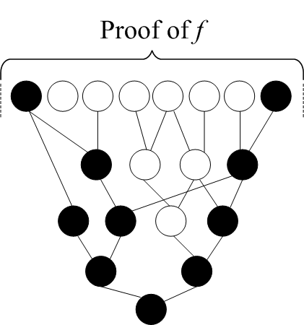
Restructuring Proofs
Color the assertion clauses and descendants black.
Color the remaining clauses white.
Resolve black nodes from white nodes.

Slide 213
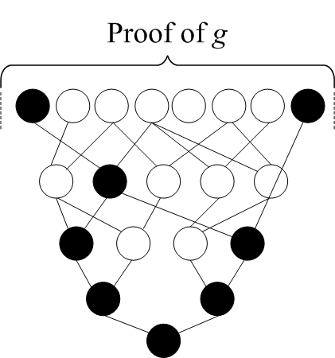
Restructuring Proofs

Slide 214
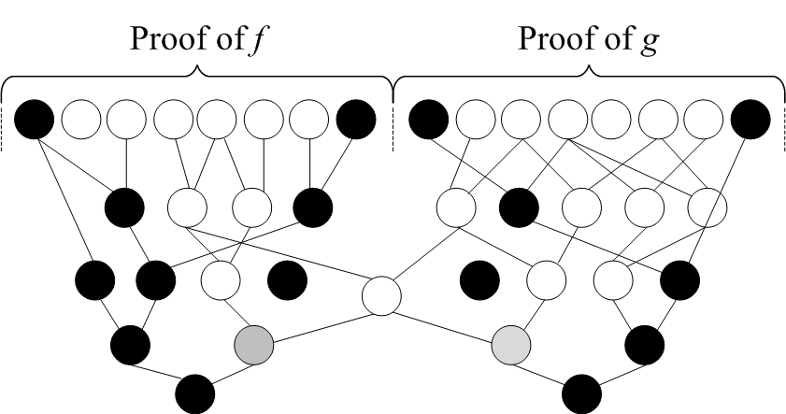
Restructuring Proofs

Slide 215
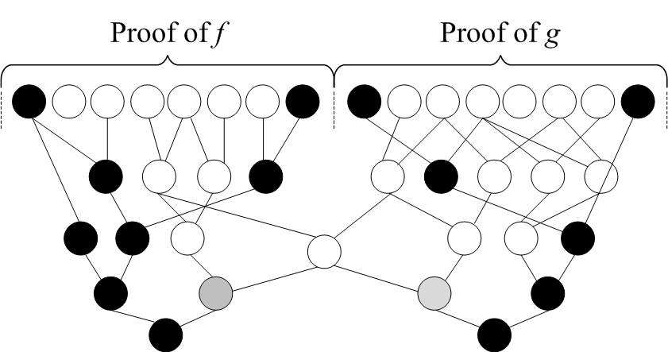
Restructuring Proofs

Slide 216
Proposition
The interpolants from restructured proofs are equivalent.
Proof:
The roots of all white clauses are present in the original SAT instance.
The global variables are the same for each SAT instance.

Slide 217
Experiment
Test to see to what extent proofs can be restructured.
How many black nodes can be resolved from white nodes?
Generated resolution proofs from benchmark circuits.
POs specified in terms of all PIs.

Slide 218
Benchmark | Orig. Num. White | Orig. Num. Black | Num. Checked | Num. Sharable | % Sharable | Time (s)
dk15 | 1743 | 581 | 581 | 175 | 30.12 | 0.04
5xp1 | 3203 | 1636 | 1636 | 275 | 16.81 | 0.18
sse | 3848 | 2650 | 2650 | 563 | 21.25 | 0.28
ex6 | 4055 | 2731 | 2731 | 588 | 21.53 | 0.29
s641 | 6002 | 5148 | 5148 | 2269 | 44.08 | 0.46
s510 | 7851 | 5092 | 5092 | 1155 | 22.68 | 0.74
s832 | 15359 | 14826 | 14826 | 3358 | 22.65 | 3.67
planet | 40516 | 43387 | 43387 | 10640 | 24.52 | 26.39
styr | 44079 | 54128 | 54128 | 16578 | 30.63 | 33.88
s953 | 49642 | 46239 | 46239 | 12252 | 26.5 | 31.99
bcd | 96385 | 109167 | 103514 | 34349 | 33.18 | 200
table5 | 137607 | 288461 | 69070 | 27848 | 40.32 | 200
table3 | 177410 | 283066 | 47279 | 24454 | 51.72 | 200

Slide 219
Discussion
Can effect large structural changes.

Slide 220
Discussion
Preliminary results show that there is significant potential for node sharing.
Techniques are highly scalable.
Calls to SAT solver are incremental.
Heuristics could improve scalability.

Slide 221
How does PDR work?
The trace contains sets of clauses F_{i} called frames.
Frame F_{i} symbolically represents over approximation of states reachable in i transitions.

Slide 222
Trace Properties
The 0th frame is initial states ( F₀ = I )
Each frame implies the next ( F_{i} → F_{i+1} )
Next states are reachable in one transition from current ( F_{i} ˄ T→ F’_{i+1} )
Every frame satisfies the property; except the last ( F_{i} → P , i ≠ n)

Slide 223
Algorithm Outline
Consists of two phases:
The blocking phase: determines if cube S can be blocked in previous time frame i-1 by solving: F_{i-1} ˄ T ˄ S’
The propagation phase: determines if cube S can be blocked in next time frame i+1 by solving: F_{i} ˄ T ˄ S’

Slide 224
PDR Example
x₁x₂x₃x₄
I
¬P
x₄ not in proof!
Query:
UNSAT!
F₀ = I
F₁
SAT!
(¬x₁˅¬x₂˅¬x₃)
F₁ ˄ T ˄ ¬P
F₀ ˄ T ˄ x’₁x’₂x’₃x’₄
*Blocking Phase*

Slide 225
PDR Example
x₁x₃x₄
I
¬P
Query:
UNSAT!
F₀ = I
F₁
SAT!
(¬x₁˅¬x₂˅¬x₃)
F₁ ˄ T ˄ ¬P
F₀ ˄ T ˄ x’₁x’₃x’₄
(¬x₁˅¬x₃˅¬x₄)
*Blocking Phase*

Slide 226
PDR Example
x₁x₅
I
¬P
Query:
UNSAT!
F₀ = I
F₁
SAT!
(¬x₁˅¬x₂˅¬x₃)
F₁ ˄ T ˄ ¬P
F₀ ˄ T ˄ x’₁x’₅
(¬x₁˅¬x₃˅¬x₄)
(¬x₁˅¬x₅)
*Blocking Phase*

Slide 227
PDR Example
I
¬P
F₀ = I
F₁
Query:
UNSAT!
(¬x₁˅¬x₂˅¬x₃)
F₁ ˄ T ˄ ¬P
(¬x₁˅¬x₃˅¬x₄)
(¬x₁˅¬x₅)
*Blocking Phase*

Slide 228
PDR Example
I
¬P
F₀ = I
F₁
F₂
Query:
UNSAT!
(¬x₁˅¬x₂˅¬x₃)
(¬x₁˅¬x₂˅¬x₃)
F₁ ˄ T ˄ x’₁x’₂x’₃
(¬x₁˅¬x₃˅¬x₄)
(¬x₁˅¬x₅)
*Propagation Phase*

Slide 229
PDR Example
I
¬P
F₀ = I
F₁
F₂
Query:
SAT!
(¬x₁˅¬x₂˅¬x₃)
(¬x₁˅¬x₂˅¬x₃)
F₁ ˄ T ˄ x’₁x’₃x’₄
(¬x₁˅¬x₃˅¬x₄)
(¬x₁˅¬x₅)
*Propagation Phase*

Slide 230
PDR Example
I
¬P
F₀ = I
F₁
F₂
Query:
SAT!
(¬x₁˅¬x₂˅¬x₃)
(¬x₁˅¬x₂˅¬x₃)
F₁ ˄ T ˄ x’₁x’₅
(¬x₁˅¬x₃˅¬x₄)
(¬x₁˅¬x₅)
*Propagation Phase*

Slide 231
PDR Example
x₆x₇
x₁x₃x₄
I
¬P
Query:
SAT!
F₀ = I
F₁
F₂
SAT!
(¬x₁˅¬x₂˅¬x₃)
(¬x₁˅¬x₂˅¬x₃)
F₂ ˄ T ˄ ¬P
F₁ ˄ T ˄ x’₁x’₃x’₄
(¬x₁˅¬x₃˅¬x₄)
(¬x₁˅¬x₅)
*Blocking Phase*

Slide 232
PDR Example
x₆x₇x₈
I
¬P
Query:
UNSAT!
F₀ = I
F₁
F₂
SAT!
(¬x₁˅¬x₂˅¬x₃)
(¬x₁˅¬x₂˅¬x₃)
F₁ ˄ T ˄ x’₁x’₃x’₄
F₀ ˄ T ˄ x’₆x’₇x’₈
(¬x₁˅¬x₃˅¬x₄)
(¬x₁˅¬x₅)
(¬x₆˅¬x₇)
x₈ not in proof!
*Blocking Phase*

Slide 233
PDR Example
I
¬P
F₀ = I
F₁
F₂
Query:
UNSAT!
(¬x₁˅¬x₂˅¬x₃)
(¬x₁˅¬x₂˅¬x₃)
F₀ ˄ T ˄ x’₆x’₇
F₁ ˄ T ˄ x’₁x’₃x’₄
(¬x₁˅¬x₃˅¬x₄)
(¬x₁˅¬x₃˅¬x₄)
(¬x₁˅¬x₅)
(¬x₆˅¬x₇)
*Blocking Phase*

Slide 234
PDR Example
x₁x₅
I
¬P
SAT!
F₀ = I
F₁
F₂
Query:
UNSAT!
(¬x₁˅¬x₂˅¬x₃)
(¬x₁˅¬x₂˅¬x₃)
F₂ ˄ T ˄ ¬P
F₁ ˄ T ˄ x’₁x’₅
(¬x₁˅¬x₃˅¬x₄)
(¬x₁˅¬x₃˅¬x₄)
(¬x₁˅¬x₅)
(¬x₁˅¬x₅)
(¬x₆˅¬x₇)
*Blocking Phase*

Slide 235
PDR Example
I
¬P
F₀ = I
F₁
F₂
Query:
UNSAT!
(¬x₁˅¬x₂˅¬x₃)
(¬x₁˅¬x₂˅¬x₃)
F₂ ˄ T ˄ ¬P
(¬x₁˅¬x₃˅¬x₄)
(¬x₁˅¬x₃˅¬x₄)
(¬x₁˅¬x₅)
(¬x₁˅¬x₅)
(¬x₆˅¬x₇)
*Blocking Phase*

Slide 236
PDR Example
I
¬P
F₀ = I
F₁
F₂
Query:
UNSAT!
(¬x₁˅¬x₂˅¬x₃)
(¬x₁˅¬x₂˅¬x₃)
F₁ ˄ T ˄ x’₆x’₇
(¬x₁˅¬x₃˅¬x₄)
(¬x₁˅¬x₃˅¬x₄)
(¬x₁˅¬x₅)
(¬x₁˅¬x₅)
(¬x₆˅¬x₇)
(¬x₆˅¬x₇)
F₁ = F₂ , F_{n} → P
*Propagation Phase*

