Slide 1
A Scalable Deterministic Approach to Stochastic Computing
Yadu Kiran, Electrical & Computer Engineering
Advisor: Marc Riedel

Slide 2
An Introduction to Stochastic Computing
Stochastic computing revolves around a non-positional encoding for numbers.
Numbers are represented as fractional values.
Operations are performed on randomly generated bitstreams.

Slide 3

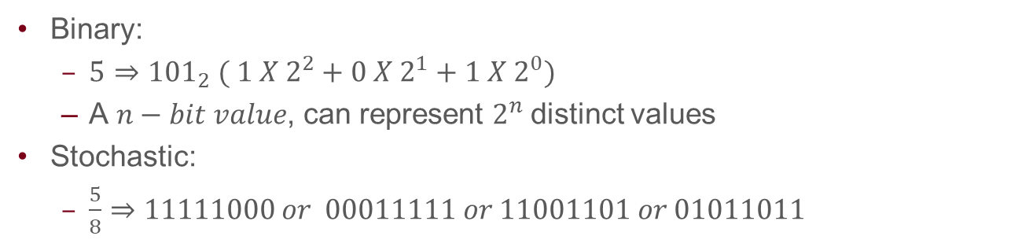

Representing Values
Binary:
  $5⇒{101}_{2} ( {1 X 2}^{2}+{0 X 2}^{1}+{1 X 2}^{0})$
  A $n−bit value$, can represent $2^{n}$distinct values
Stochastic:
  $\frac{5}{8}⇒11111000 or 00011111 or 11001101 or 01011011$
Bitstream
Generator
$$X\left(t\right)= 1 0 1 1 0 0$$
$$P(X\left(t\right)==1)=x$$
  A $n−bit bitstream$ can only represent $n$ distinct values.

Slide 4
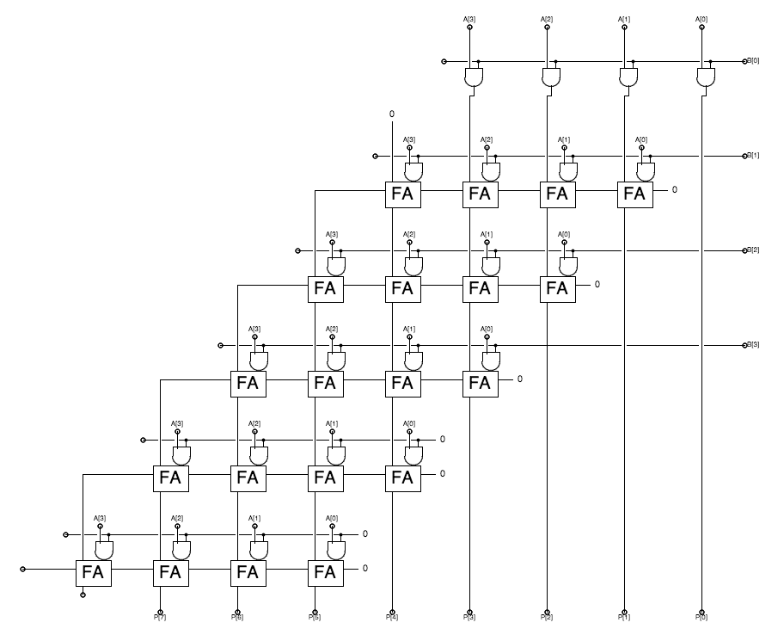

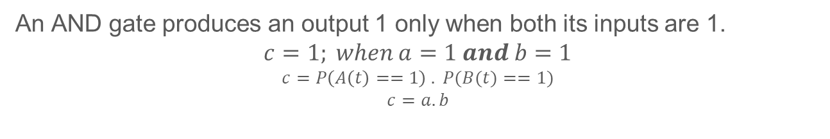
A Multiply Circuit
a = 6/8
c = 3/8
1,1,0,1,0,1,1,1
1,1,0,0,0,0,1,0
AND
1,1,0,0,1,0,1,0
b = 4/8
A 4-bit Multiplier
A Stochastic Multiplier
$$Number of Gates=6.n^{2}$$
$$Number of Gates=1^{∗}$$
An AND gate produces an output 1 only when both its inputs are 1.
$$c=1; when a=1 and b=1$$
$$c=P\left(A\left(t\right)==1\right) . P(B(t)==1)$$
$$c=a.b$$

Slide 5





Scaled Addition and Arbitrary Polynomials
2/5
3/5
$$x_{1}$$
$$\text{10100}$$
$$x_{2}$$
$$1$$
$$\text{10101}$$
$$y$$
$$\text{11101}$$
$$0$$
4/5
$$s$$
$$\text{11010}$$
3/5
$$\text{Scaled} \text{Addition}$$
$$Bernstein Polynomial$$

Slide 6
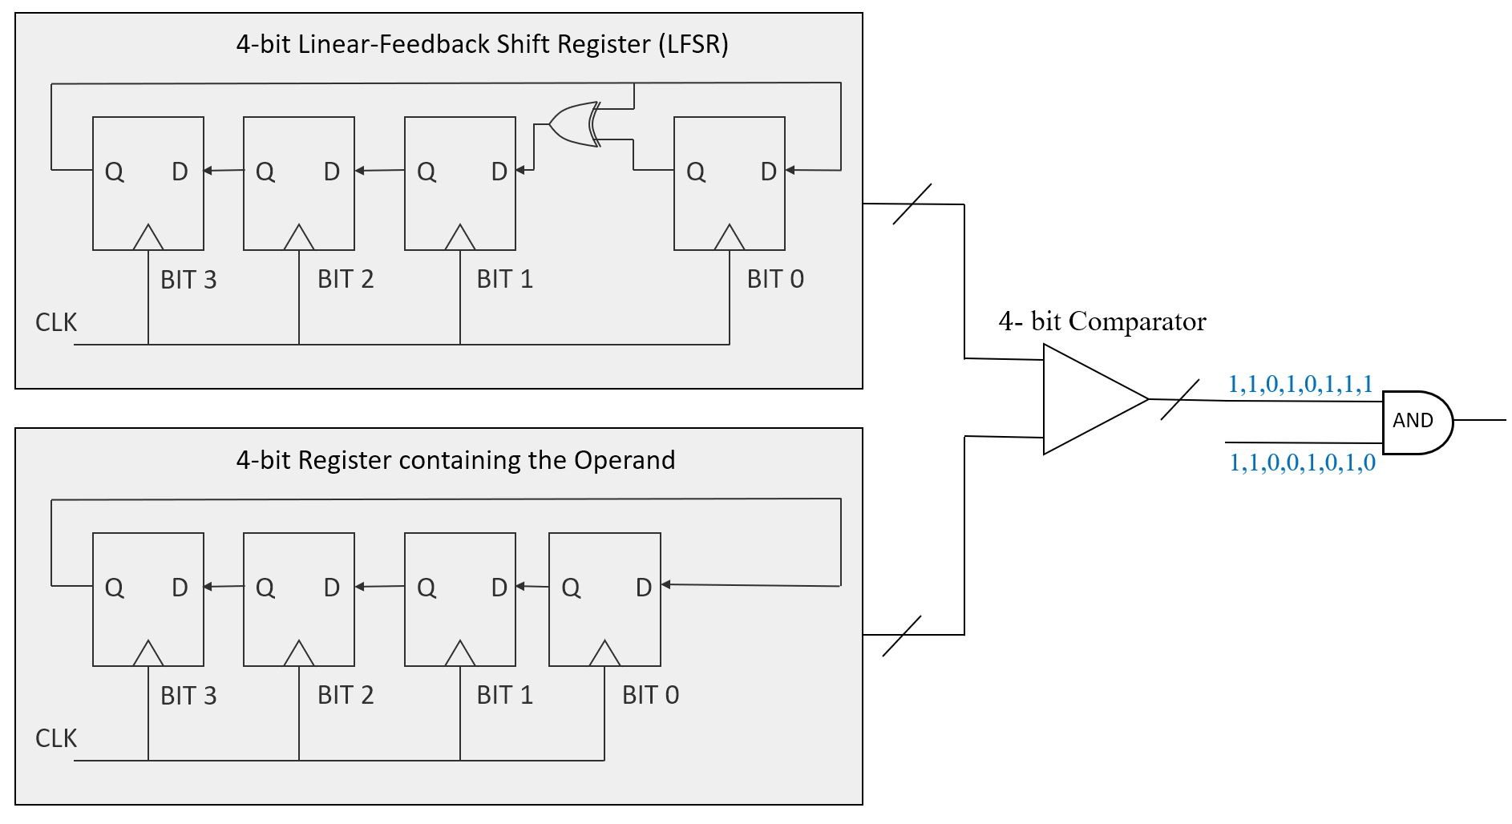

*
  Randomness is neither free nor cheap!
$$Real Gate Cost=20n to 30n$$

Slide 7
Advantages and Drawbacks
Stochastic Computing is innately fault-tolerant.
  But requires more bits to represent the same range of values.
Circuit structures are simpler than their binary counterparts
  But they are not perfectly accurate.
Accuracy can be improved by using longer bit-streams.
  But this results in longer latency.
a = 6/8
c = 1/8
1,1,0,0,1,1,0,1
0,1,0,0,0,0,0,0
AND
0,1,0,1,0,0,1,0
b = 4/8

Slide 8
But is randomness necessary?
90-95% of the circuit area is dedicated to generating those random bit-streams.
Jenson and Riedel demonstrated that by generating bit streams deterministically, one can obtain perfectly accurate results.
(A deterministic approach to stochastic computation, ICCAD 2016)
Every bit of one operand must be matched up against every bit of the second operand(s) exactly once.

Slide 9

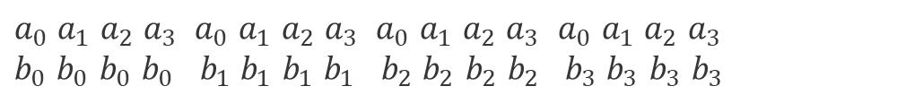

Deterministic approach
This could be achieved by three techniques:
  Rotation
  Clock-Division
  Relatively Prime Length Bit Streams
$$A=a_{0}a_{1}a_{2}a_{3}$$
$$B=b_{0}b_{1}b_{2}b_{3}$$
$a_{0}$ $a_{1}$ $a_{2}$ $a_{3}$ ${ a}_{0}$ $a_{1}$ $a_{2}$ $a_{3}$ ${ a}_{0}$ $a_{1}$ $a_{2}$ $a_{3}$ $a_{0}$ $a_{1}$ $a_{2}$ $a_{3}$
$b_{0}$ $b_{0}$ $b_{0}$ $b_{0}$ ${ b}_{1}$ $b_{1}$ $b_{1}$ $b_{1}$ ${ b}_{2}$ $b_{2}$ $b_{2}$ $b_{2}$ ${ b}_{3}$ $b_{3}$ $b_{3}$ $b_{3}$
Clock-Division Method

Slide 10








Putting it together
A
Bit-stream A
$$Deterministically generated bit streams$$
CLK
Counter
$$[{0,2}^{n})$$
$\text{A}\text{⇒}$ 1/4 $\text{⇒}$1000
$\text{B}\text{⇒}$ 3/4 $\text{⇒}$1110
$\text{A}\text{⇒}$ 1000 1000 1000 1000
1000 1000 1000 0000 $\text{⇒}\frac{\text{3}}{\text{16}}$
B
Bit-stream B
$\text{B}\text{⇒}$ 1111 1111 1111 0000
Counter
$$[{0,2}^{n})$$

Slide 11
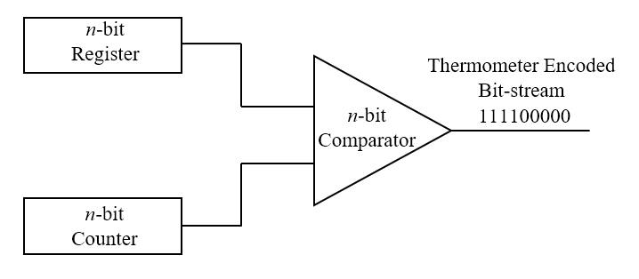
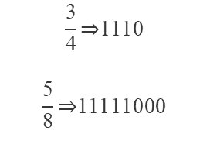
The Thermometer Encoding
All the 1’s are grouped together and appear consecutively, as well as all the 0’s.
$$\frac{\text{3}}{\text{4}}\text{⇒}\text{1110}$$
$$\frac{\text{5}}{\text{8}}\text{⇒}\text{11111000}$$
This encoding is not a requirement, but a consequence of the circuit used to generate deterministic bit streams.

Slide 12
Problem solved?
The Deterministic Approach solves the problem of inaccuracy
But it does not solve the issue of long latency.
The number of bits at the output is the product of the number of bits of all its inputs
This is a mathematical requirement for full precision.
But this exponential increase in latency becomes intolerable for large circuits.

Slide 13

Goal
For a given set of input operands of length $n bits$, compute the output as $n bits,$in $n$clock cycles, producing the most mathematically accurate result possible

Slide 14
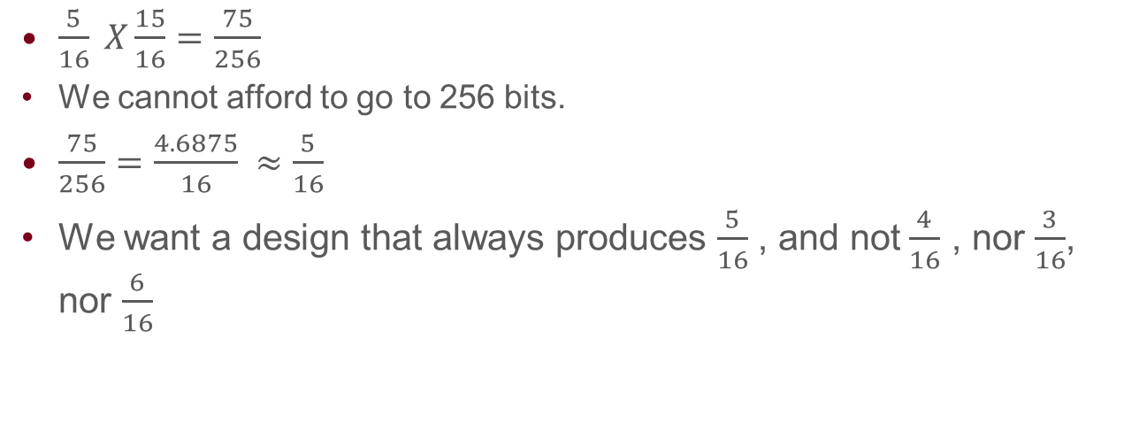
An Example
$\frac{5}{16} X\frac{15}{16}=\frac{75}{256}$
We cannot afford to go to 256 bits.
$\frac{75}{256}=\frac{4.6875}{16} ≈\frac{5}{16}$
We want a design that always produces $\frac{5}{16}$ , and not$\frac{4}{16}$ , nor $\frac{3}{16}$,
nor $\frac{6}{16}$

Slide 15
A naïve attempt
The length of the output bit-stream is proportional to the size of the input bit-stream.
11 11 11 00 00
1 1 1 0 0
Original bit-stream
Down-sampled bit-stream
The downscaled/downsampled bit-stream is an approximation, and we run into errors again.

Slide 16



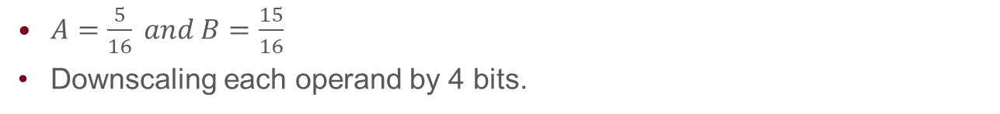
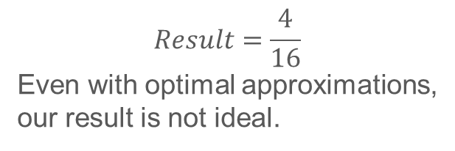


Back to our Example
$A=\frac{5}{16} and B=\frac{15}{16}$
Downscaling each operand by 4 bits.
$$A$$
$$B$$
1111 1000 0000 0000
Original bit-stream
1111 1111 1111 1110
1 0 0 0
1 1 1 1
Down-sampled bit-stream
With Optimal Approximation $A ≈\frac{1}{4}$ and $B ≈\frac{4}{4}$
1000 1000 1000 1000
$$Result=\frac{4}{16}$$
Even with optimal approximations,
our result is not ideal.
$$A⇒$$
$$B⇒$$
1111 1111 1111 1111
$$C⇒$$
1000 1000 1000 1000

Slide 17
A Better Attempt
Exploit the predictable nature of Thermometer Encodings
11 11 10 00 00
Original bit-stream
Sampled bit = 1
Sampled bit = 0
11 11 10 00 00
1 1 1 0 0
11 11 10 00 00
1 1 0 0 0
Original bit-stream
Original bit-stream
Down-sampled bit-stream
Down-sampled bit-stream

Slide 18
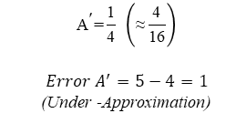

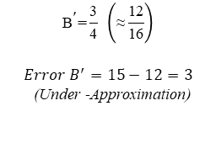

The Example
$$\text{A}\text{=}\frac{\text{5}}{\text{16}}$$
$$\text{B}\text{=}\frac{\text{1}5}{\text{16}}$$
Original bit-stream
1111 1000 0000 0000
1111 1111 1111 1110
Rounding down
Rounding down
1000
Down-scaled bit-stream
1110
$${\text{A}}^{\text{′}}\text{=}\frac{\text{1}}{\text{4}} \left(\text{≈}\frac{\text{4}}{\text{16}}\right)$$
$$Error A^{′}=5−4=1$$
(Under -Approximation)
$${\text{B}}^{\text{′}}\text{=}\frac{\text{3}}{\text{4}} \left(\text{≈}\frac{\text{12}}{\text{16}}\right)$$
$$Error B^{′}=15−12=3$$
(Under -Approximation)

Slide 19
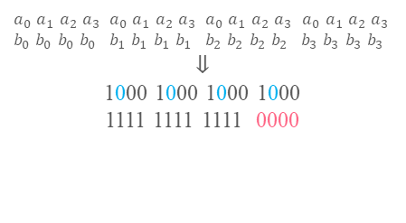
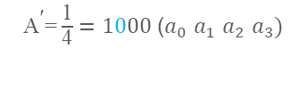



The Example
${\text{A}}^{\text{′}}\text{=}\frac{\text{1}}{\text{4}}=1000$ ($a_{0}$ $a_{1}$ $a_{2}$ $a_{3})$
${\text{B}}^{\text{′}}\text{=}\frac{\text{3}}{\text{4}}=1110$ ($b_{0}$ $b_{1}$ $b_{2}$ $b_{3})$
Error ${\text{A}}^{\text{′}}$ = 1
Error ${\text{B}}^{\text{′}}$= 3
The bits that we highlighted are carrying partially incorrect information.
The bit is repeated in the clock-division process.
$a_{0}$ $a_{1}$ $a_{2}$ $a_{3}$ ${ a}_{0}$ $a_{1}$ $a_{2}$ $a_{3}$ ${ a}_{0}$ $a_{1}$ $a_{2}$ $a_{3}$ $a_{0}$ $a_{1}$ $a_{2}$ $a_{3}$
$b_{0}$ $b_{0}$ $b_{0}$ $b_{0}$ ${ b}_{1}$ $b_{1}$ $b_{1}$ $b_{1}$ ${ b}_{2}$ $b_{2}$ $b_{2}$ $b_{2}$ ${ b}_{3}$ $b_{3}$ $b_{3}$ $b_{3}$
$⇓$
1000 1000 1000 1000
1111 1111 1111 0000
Use this opportunity to correct those erroneous bits by inverting them.

Slide 20

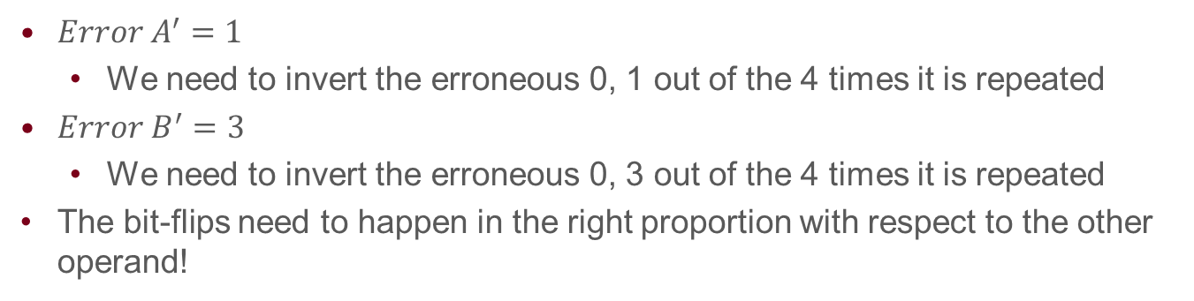

The Example
1000 1000 1000 1000
1111 1111 1111 0000
$$A⇒$$
$$B⇒$$
$Error A^{′}=1$
  We need to invert the erroneous 0, 1 out of the 4 times it is repeated
$Error B^{′}=3$
  We need to invert the erroneous 0, 3 out of the 4 times it is repeated
The bit-flips need to happen in the right proportion with respect to the other operand!

Slide 21




The Example
1000 1000 1000 1000
1111 1111 1111 0000
$⇓$
1100 1000 1000 1000
1111 1111 1111 1110
$$A⇒$$
$$B⇒$$
$Inv\left(A^{′}\right)=Error A^{′} ∗ B^{′}$
$= 1 ∗\frac{3}{4}$
$≈1$
$Inv\left(B′\right)=Error B^{′} ∗ A^{′}$
$= 3 ∗\frac{1}{4}$
$≈1$
This is another stochastic multiply operation!

Slide 22




With Error Compensation!
$$A⇒$$
1100 1000 1000 1000
$$B⇒$$
1111 1111 1111 1110
$$Result=\frac{5}{16}$$
$$C⇒$$
1100 1000 1000 1000
This matches our ideal answer!

Slide 23
The cost of additional multiplication
We need to determine which bits to invert before we do the main operations.
Computing which bits to invert, requires the same number of clock cycles as our main operation
This doubles our latency.

Slide 24







Not as bad as it seems!
The multiply operation to determine which bits to invert, is independent of the main operation.
Let’s Pipeline it! Throughput remains the same.
Determining errors and Downscaling is accomplished by bit shifts
$$A=\frac{5}{16}=0101$$
$$A′=\frac{1}{4}(Higher Order Bits)$$
$$0$$
$$1$$
$$0$$
$$1$$
$$Error A′=\frac{1}{4}(Lower Order Bits)$$

Slide 25
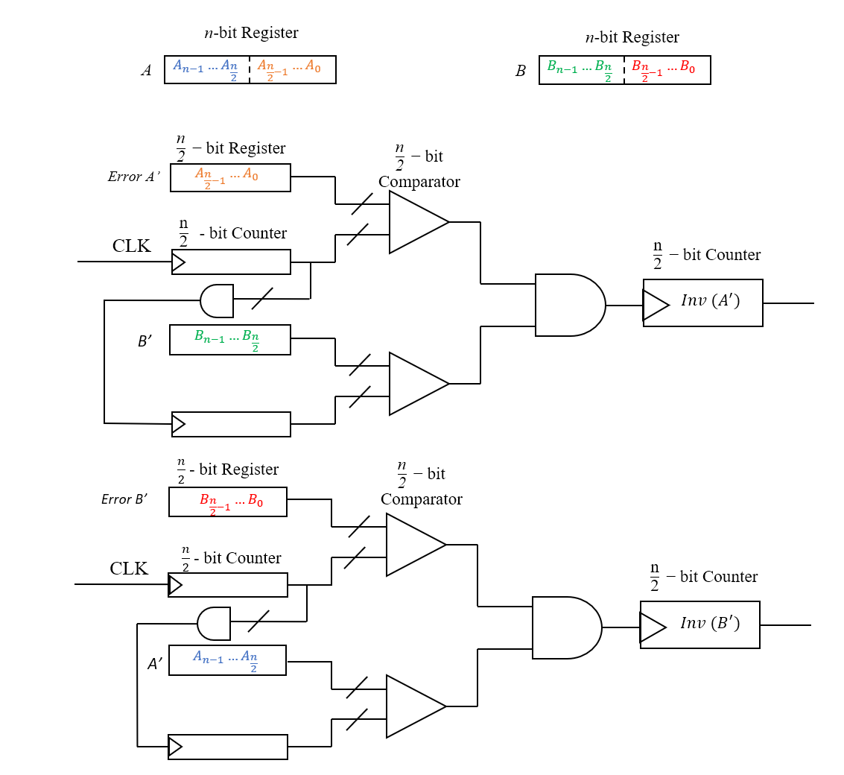
The Final Circuit

Slide 26


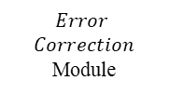







The Final Circuit
$\frac{\text{n}}{\text{2}}$ - bit Register
$\frac{\text{n}}{\text{2}}$- bit Comparator
A’
$$A_{n−1}…A_{\frac{n}{2}}$$
$\frac{\text{n}}{\text{2}}$ - bit Counter
CLK
$$\text{Inv}\text{ (}{\text{A}}^{\text{′}}\text{)}$$
$$Error \\ Correction$$
Module
Final Output Bitstream
$$\text{Inv}\text{ (}{\text{B}}^{\text{′}}\text{)}$$
$\frac{\text{n}}{\text{2}}$ - bit Register
$\frac{\text{n}}{\text{2}}$- bit Comparator
B’
$$B_{n−1}…B_{\frac{n}{2}}$$
$\frac{\text{n}}{\text{2}}$ - bit Counter

Slide 27
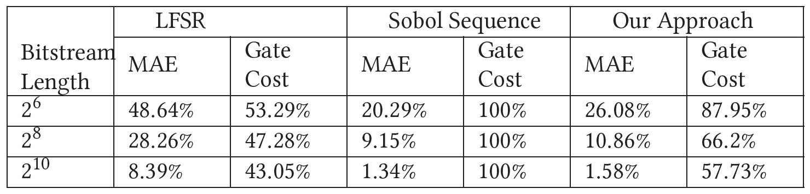
Comparisons
We evaluated our methods against the conventional stochastic techniques that employ LFSRs, and Sobol Sequences.
Note: 0 error is not possible as we are losing the precision in terms of bits and the values we can represent.

Slide 28
Comparisons

Slide 29
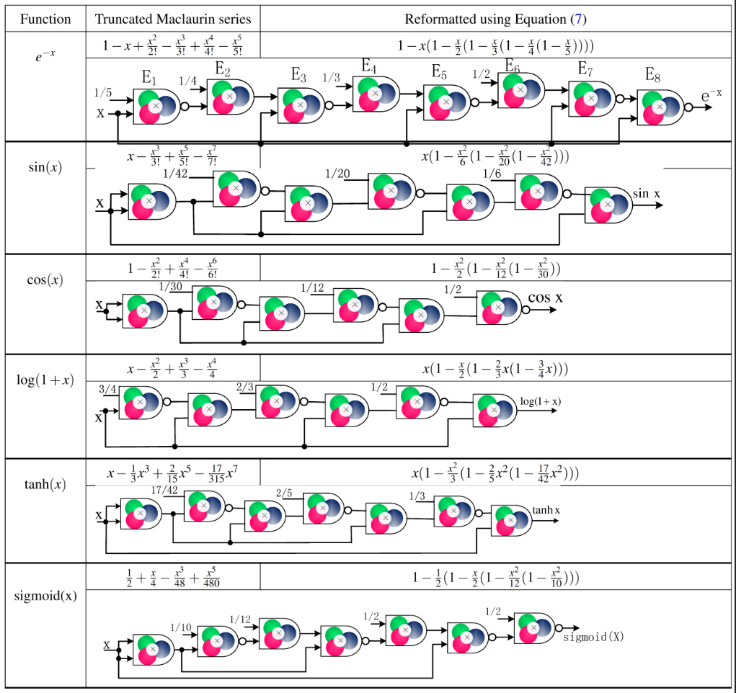
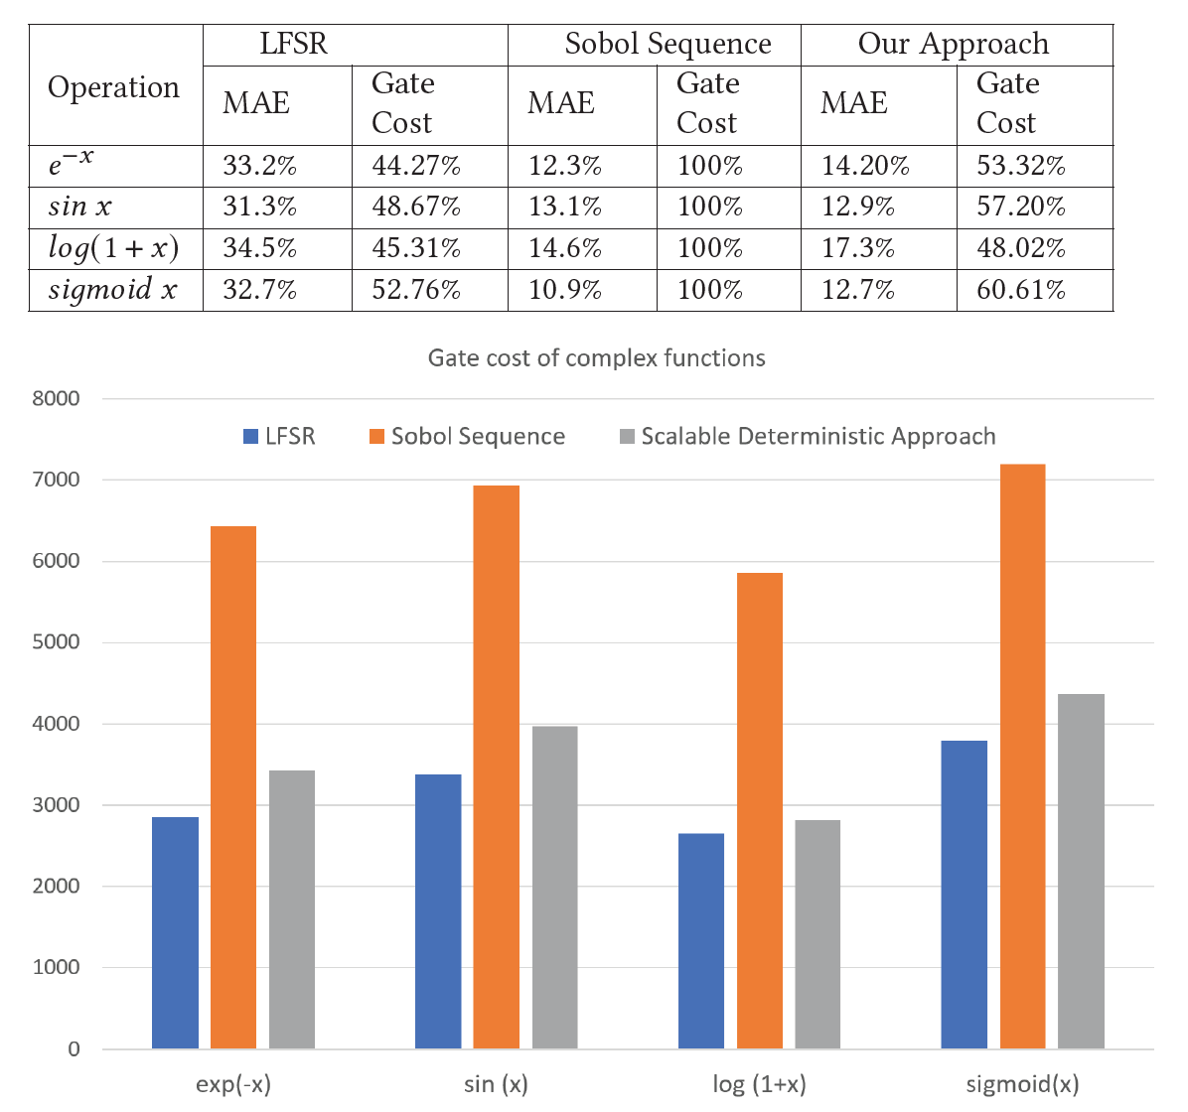
Complex functions

Slide 30
Thank You!
Questions?

Slide 31



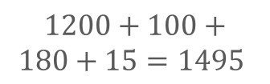


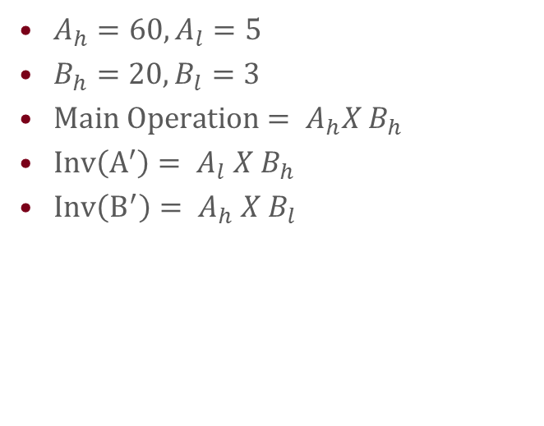




Multiplication with Partial Products
$65 X 23=1495$
$A_{h}=60,A_{l}=5$
$B_{h}=20,B_{l}=3$
$Main Operation= A_{h}X B_{h}$
$Inv\left(A^{′}\right)= A_{l} X B_{h}$
$Inv\left(B^{′}\right)= A_{h} X B_{l}$
$$60$$
$$5$$
$$20$$
$$1200$$
$$100$$
$$3$$
$$180$$
$$15$$
$1200+100+180+15=1495$

Slide 32


